Slide 1


NYC Greenhouse Gas Inventory
Isabela Brown
Anthony Perez
July 15th, 2026

Slide 2


Agenda
2024 Emissions Results
Inventory Methodology
NYC GHG Inventory Grid Coefficient
Questions & Discussion

Slide 3
2024 Greenhouse Gas Emissions Results
“

Slide 4
Citywide Inventory Takeaways
There was a 5% decrease in greenhouse gas emissions since 2023 driven by fuel oil and natural gas reductions in buildings.
Sector | Emissions Change from 2023 | Drivers of Change from 2023
Buildings | Decreased | Natural gas and fuel oil reductions
Transportation | Largely Stayed the Same | Increased both heavy duty traffic and for-hire electrification
Waste | Increased | Increased landfilled waste while organics processing expanded
Total | Decreased | Natural gas and fuel oil reductions

Slide 5
City Government Operations Inventory Takeaways
There was a 4% decrease in emissions from FY23 driven by conversion of diesel to renewable diesel for City fleet.
Sector | Change from 2023 | Drivers of Change from 2023
Buildings | Decrease | Net reduction in fuel oil and conversion to cleaner fuel with higher biodiesel content
Transportation | Decrease | Conversion from Diesel to Renewable Diesel (On-Road Vehicles)
Streetlights and Traffic Signals | Increase | Slight increase from energy consumption and grid coefficient
Wastewater Treatment | Increase | Increase driven by variability in venting at DEP facility
Water Supply | Decrease | Slightly lower energy consumption across all types
Solid Waste Facilities | Decrease | Decrease due to resolution of venting system at DSNY facility

Slide 6
NYC Inventory Methodology
“

Slide 7


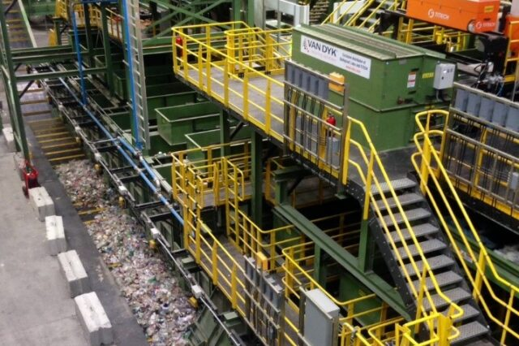
Inventory Basics
Purpose:
Track the City’s progress toward its emissions reduction mandates:
  Reduce citywide emissions by 40% and city government emissions by 50% by 2030
  Reach net-zero emissions by 2050
Identify opportunities to reduce emissions
Support policy development and implementation:
  Climate Budgeting emissions forecasting
  LL97 tracking
Standardized methods to benchmark against other municipalities
The GHG Inventory is published on November 15th
History:
  2025 marks 20 years of Inventory data reporting

Slide 8














Inventory Data Is Collected from Various Partners
Utilities & Fuel Oil Vendors
Transportation Entities
Government Agencies

Slide 9
Yearly Inventory Cycle
May
Data Requests
December
Result Share Outs
  Sent to data partners, end of May
  Roadshow to present results
November
June
Publish Inventory
Data Processing
  Mandated deadline, November 15
  Format data for analysis
October
July
Final Grid Coefficient
Quality Assurance & Control
  Use finalized data for final coefficient
  Assess data for anomalies
September
August
Data Analysis
Interim Grid Coefficient
  Analyze trends and drivers of change
  Use preliminary data to estimate coefficient

Slide 10
NYC GHG Inventory Grid Coefficient
“

Slide 11
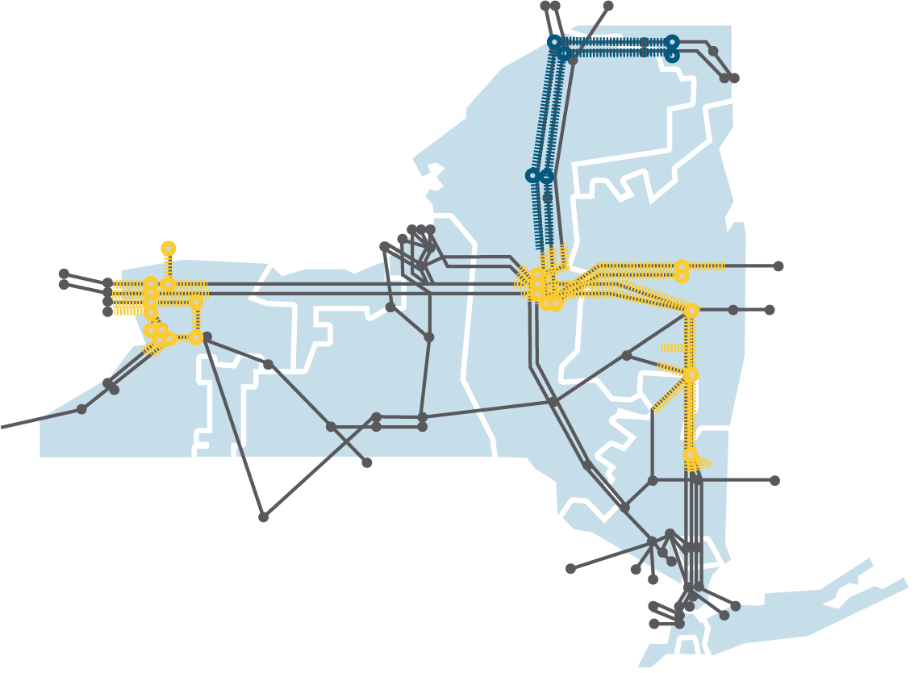
Where does NYC Electricity come from?
NYC imports electricity from outside the City to meet demand
Most electricity generation in NYC is powered by fossil fuels
Transmission lines deliver electricity from fossil fuel and clean energy power plants located across New York State and New Jersey
NYISO Transmission System
Notes:
NYISO=New York Independent System Operator

Slide 12
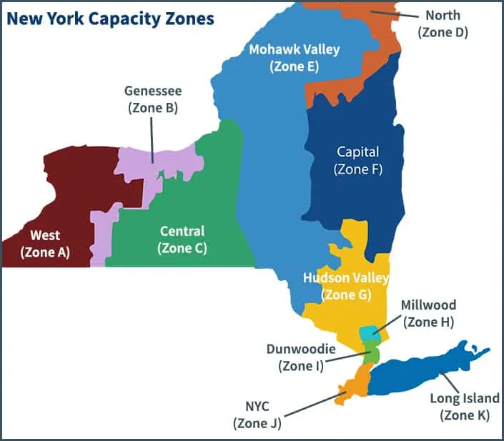
How is the NYC GHG Inventory Grid Coefficient Calculated?
Data input sources: U.S. EPA, NY Independent System Operator (NYISO), Utility Data
Assumptions for calculating the grid’s emissions intensity:
  100% of power generation in NYC serves NYC
  100% of imported power from New Jersey serves NYC
  The remaining demand is served from a split of 60% from upstate sources and 40% from Westchester and the Hudson Valley
  Long Island power generation does not currently serve NYC

Slide 13
2024 NYC Grid Coefficient Results
NYC generation serves about 50-60% of NYC demand
Remaining demand is met by imports from Upstate, Westchester/Hudson Valley, and New Jersey
Grid is more reliant on NYC generation and NJ imports since the closure of Indian Point Nuclear Power Plant in April 2021

Slide 14
New Normal: Less Zero Emissions Energy on our Grid
After Indian Point Closure:
  More reliance on In-City natural gas power plants and transmissions from NJ
  Less available zero-emission energy sources due to transmission constraints
Underscores importance of Champlain Hudson Power Express (CHPE) and large-scale renewables like Empire Wind
Indian Point Closure
20%
zero emissions
80% fossil fuels

Slide 15
How is the Inventory Coefficient Different?
 | NYC GHG Inventory | LL97 | EPA eGrid (NYCW Subregion)
Generation Region Included in Coefficient: | NYC & Westchester Generation + NJ and Upstate Imports | NYC & Westchester Generation | NYC & Westchester Generation
Purpose: | Annual retrospective modeling of generation, transmission, and electricity imports | Default LL97 compliance coefficient fixed in 2019 to provide regulatory certainty and support building capital-planning cycles. Note: established while Indian Point was operational and does not represent today’s grid mix. | US regional zones developed by EPA to track power plant emissions within set subregions.
Applicable Data Year | 2024 | 2024 – 2029* (based on 2017-18 estimates) | 2023
*0.000288962 tCO₂e/kWh for compliance years 2024–2029; numerically consistent with EPA eGRID2016 NYCW Subregion data published in 2018.

Slide 16
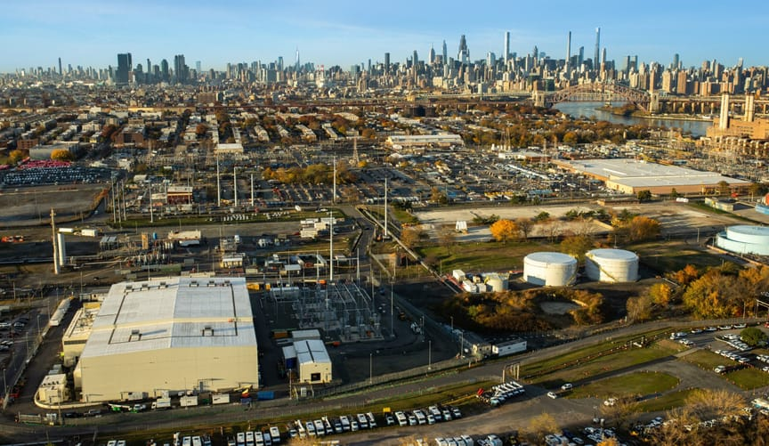

Look Ahead for the NYC Electricity Grid
Champlain Hudson Power Express (CHPE) became operational in May 2026 delivering 1,250 MW of power annually
Empire Wind 1 is expected to become operational in 2027 delivering 810 MW of power annually
Interim emissions reductions goals are here and fast approaching
It's crucial to reflect developments to the electric grid in the NYC GHG Inventory Grid Coefficient

Slide 17
Thank You
Isabela Brown
Senior Policy Advisor, ibrown@climate.nyc.gov
Anthony Perez
Policy Advisor, anperez@climate.nyc.gov
July 2026

Slide 18
Questions & Discussion
“

Slide 19
Appendix
“

Slide 20
NYC Buildings are More Energy Efficient Than Ever Before
Buildings are our largest source (70%) of citywide emissions and emission reductions
NYC building energy usage is at all time low
Building energy decreases driven by:
  Over 70% reduction in fuel oil since 2005 due to phase out legislation
  Lowest natural gas use in the last decade
  Pandemic-driven drops in commercial building electricity usage

Slide 21
Natural Gas Usage at its Lowest in the Last Decade
Beyond weather, pandemic, and population impacts, natural gas is still reducing for both utilities due to efficiency
Reductions driven by a steep decline in residential natural gas
Total natural gas consumption reductions are consistent across utilities
  National Grid: -16% from 2023
  Con Ed: -13% from 2023
Decade
low

Slide 22
New Normal: Commercial Building Electricity Usage Remains Consistently Below Pre-Pandemic Levels
Impact of the pandemic on businesses and commercial sector drove over half of the electricity reductions since 2019, largely due to:
  Smarter operations: Modified or shortened hours of operation reducing energy usage (i.e. shutting off building systems overnight)
  Energy Efficiency Upgrades: Many buildings completed long-overdue commercial energy efficiency upgrades during the pandemic
  More vacancy: There are twice as many vacant offices as in 2019
Trend is consistent even when normalizing for building square footage
Notes:
Results corroborated with Urban Green Council analysis conducted in 2025.

